Slide 1

Technology: Python
MACHINE LEARNING MODEL FOR PREDICTION OF SMARTPHONE ADDICTION

Slide 2
INDEX
Abstract
Objective
Future scopes
Problem statement
Introduction
Literature review
Existing Method
Drawbacks
Proposed method
Advantages
Applications
Implementation
Modules
Hardware and Software Requirements
Algorithms
UML Diagrams
Results
Conclusion
References

Slide 3
OBJECTIVE
The primary goal of this project is to determine the prediction of smartphone addiction and to know this we have used classification techniques.
FUTURE SCOPES
In future research, the focus can be on developing more accurate prediction models for smartphone addiction using advanced classification techniques, such as deep learning algorithms. Additionally, investigating the impact of different demographic and psychological factors on smartphone addiction can provide valuable insights for prevention and intervention strategies.

Slide 4
PROBLEM STATEMENT
The problem statement of this project is to accurately predict smartphone addiction using classification techniques. The primary goal is to develop a model that can effectively classify individuals as either addicted or not addicted based on relevant features, ultimately aiding in understanding and addressing the issue of smartphone addiction.

Slide 5
ABSTRACT
Smartphone addiction has become a growing concern in recent years, with increasing numbers of people exhibiting symptoms such as excessive phone use, loss of productivity, and even physical and psychological health problems. As a result, there is a need to develop effective tools for predicting smartphone addiction and identifying those at risk.
In this study, we developed a machine learning model for predicting smartphone addiction using data collected from a survey of smartphone users. The survey included questions about demographics, phone use patterns, and various psychological factors such as anxiety, depression, and stress. a popular and effective machine learning method, to build our model. We preprocessed the data by encoding categorical variables and normalizing numerical variables to ensure the model could learn effectively. We then trained the model on a portion of the data and evaluated its performance on the remaining data using several metrics such as accuracy.

Slide 6
Our results showed that the model achieved a high accuracy of in predicting smartphone addiction. The most important features for predicting addiction were phone use patterns such as the frequency of checking notifications, the number of hours spent on the phone each day, and the types of apps used most frequently. Other important factors included age, gender, and stress levels.The model we developed has several potential applications. It could be used by healthcare professionals to identify individuals who are at risk of developing smartphone addiction and provide appropriate interventions. It could also be used by app developers to design apps that are less addictive and promote healthier phone use habits. In conclusion, our study demonstrates the feasibility and effectiveness of using machine learning models for predicting smartphone addiction. Further research is needed to validate our findings on larger and more diverse datasets and to explore the potential applications of this model in different contexts.
Keywords: Decision tree, Random Forest, Logistic Regression and Machine learning techniques.

Slide 7
INTRODUCTION
Smartphones have become an integral part of our lives, and their usage has increased dramatically over the past decade. While smartphones offer numerous benefits, excessive smartphone usage can lead to addiction and have negative impacts on individuals' physical and mental health, social relationships, and productivity. Machine learning can be used to develop models that can predict smartphone addiction based on various features such as smartphone usage patterns, social media usage, demographic information, and psychological factors. These models can help identify individuals who are at risk of smartphone addiction and provide them with appropriate interventions and support. To develop a machine learning model for predicting smartphone addiction, one would typically start by collecting data from a large sample of individuals. This data would include information about their smartphone usage patterns, social media usage, demographic information such as age, gender, and psychological factors such as anxiety, depression, and stress levels. Once the data is collected

Slide 8
it is preprocessed and cleaned to remove any missing or irrelevant data points. Next, a suitable machine learning algorithm is selected, such as logistic regression, decision tree, or Random Forest, based on the nature of the data and the problem at hand. The data is then split into two sets, a training set and a testing set. The training set is used to train the machine learning model by feeding it with input features and corresponding output labels. The model learns to recognize patterns in the data and establish a relationship between the input features and the output labels. Once the model is trained, it is tested on the testing set to evaluate its performance. The performance of the model is measured using various metrics such as accuracy. The model is further refined by tweaking its parameters or selecting different algorithms until satisfactory performance is achieved. Once the model is developed, it can be used to predict smartphone addiction in individuals by feeding their input features into the model.

Slide 9
The model outputs a probability score indicating the likelihood of smartphone addiction. Based on this score, appropriate interventions and support can be provided to individuals at risk of addiction. In conclusion, machine learning models can be a valuable tool for predicting smartphone addiction and identifying individuals at risk. These models can help individuals and healthcare professionals take proactive measures to prevent addiction and mitigate its negative effects. However, it is essential to collect high-quality data and develop accurate and reliable models that can be effectively used in real-world settings.

Slide 10
S. No | Journal Type with year | Authors | Title | Outcomes
1 | IEEE, 2018 | Demir, K. & Akpinat | The effect of mobile learning applications on students’ | In this paper impact of mobile learning applications on undergraduate students' academic performance is investigated in this research
2 | IEEE, 2021 | Abadiyan, F., Hadadnezhad | Adding a smartphone app to global postural re-education to improve neck pain, posture, quality of life, and endurance in people with nonspecific neck pain | In this research, the impact of incorporating a smartphone app into an 8-week global postural reeducation (GPR) programme on patients' neck pain

Slide 11
S. No | Journal Type with year | Authors | Title | Outcomes
3 | IEEE, 2021 | BMC Musculoskelet. Disord | The relationship between smartphone usage duration | This project's goal was to Young people in particular are increasingly using smartphones for activities other than conversation, such as gaming and browsing the internet
4 | IEEE, 2021 | Hitti, E., Hadid, D., Melki, J | Mobile device use among emergency department healthcare professionals | In this paper Healthcare workers frequently use mobile devices, which are becoming more and more integrated into the industry

Slide 12
EXISTING METHOD
In the existing system, implementation of machine learning algorithms is bit complex to build due to the lack of information about the data visualization. Mathematical calculations are used in existing system for Logistic Regression model building this may takes the lot of time and complexity. To overcome all this, we use machine learning packages available in the scikit-learn library.
disadvantages:
1. requires more time
2. difficult to handle

Slide 13
PROPOSED METHOD
Many machine learning algorithms are available for prediction of smartphone addiction Some of the machine learning algorithm are Decision Tree, Random Forest We used proposed and compute best method for diagnosis a comparative study of machine learning techniques for smartphone addiction detection In this stage we have first implement these dataset and the implement algorithm individual then we are combine these results and an compute the Accuracy.
Advantages:
1. Requires less time
2. Good Accuracy
3. Easy to handle

Slide 14
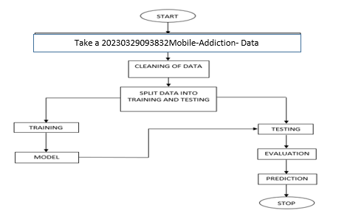
BLOCK DIAGRAM

Slide 15
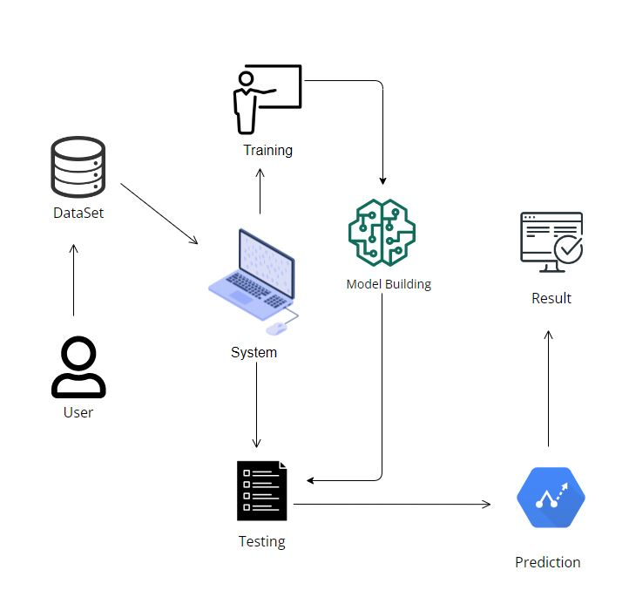
ARCHITECTURE

Slide 16
IMPLEMENTATION
first we have taken 20230329093832Mobile-Addiction extended data .
load the dataset into work environment and made a check for null values if any.
after checking the null values split the data in to train data and test data.
after splitting apply the algorithm and fit the train data and test data.
we got the best Accuracy of Decision Tree.
later, the entire work is done with django framework
user can view the home, about, view page, model training, prediction.
after detection, we will get to know the prediction of Mobile Addiction model machine learning model detection whether the result is Addicted ,not addicted are maybe addicted.

Slide 17
APPLICATIONS
Early Intervention: Classification models can be used to identify individuals who are at a higher risk of developing smartphone addiction. By analyzing various features such as app usage patterns, screen time, and behavioral data, the model can identify early warning signs and prompt intervention strategies to prevent addiction from escalating.
Targeted Intervention: Classification models can be used to identify specific groups or demographics that are more prone to smartphone addiction. This information can be used to develop targeted intervention programs tailored to address the needs of these groups, such as adolescents, young adults, or individuals with specific psychological traits.

Slide 18
HARDWARE & SOFTWARE REQUIREMENTS
H/W Configuration:
• Processor - I3/Intel Processor
• Hard Disk -160GB
• RAM - 8Gb
S/W Configuration:
• Operating System : Windows 7/8/10 .
• IDE : Pycharm.
• Libraries Used : Numpy, Pandas, OS,django, MySQL.
• Technology : Python 3.6+.

Slide 19
MODULES:
1. User:
1.1 Register:
Users can register for the mobile web application here.
1.2 Login:
After registering, the user can access his portal.
1.3 View Data:
View data What are the Data There in dataset(cleaned dataset)
1.4 Input :
User will give the input values.

Slide 20
Take Dataset:
The dataset for the 20230329093832Mobile-Addiction Data is collected from the kaggle website (kaggle.com).
The size of overall dataset is 80.0 KB (81,920 bytes).
Pre-processing:
• In preprocessing first of all we will check whether there is any Nan values.
• If any Nan values is present we will fill the Nan values with different fillna techniques like bfill, ffill, mode, and mean.
• Here we used the ffill (front fill) technique on our project.
Training the data:
Irrespective of the algorithm we select the training is the same for every algorithm.
Given a dataset we split the data into two parts training and testing, the reason behind doing this is to test our model/algorithm performance just like the exams for a student the testing is also exam for the model.

Slide 21
We can split data into anything we want but it is just good practice to split the data such that the training has more data than the testing data, we generally split the data.
And for training and testing there are two variables X and Y in each of them, the X is the features that we use to predict the Y target and same for the testing also.
Then we call the .fit ( ) method on any given algorithm which takes two parameters i.e., X and Y for calculating the math and after that when we call the .predict ( ) giving our testing X as parameter and checking it with the accuracy score giving the testing Y and predicted X as the two parameters will get our accuracy score and same steps , these are just checking for how good our model performed on a given dataset.

Slide 22
Algorithms
1 .Decision Tree:
A tree has many analogies in real life, and turns out that it has influenced a wide area of machine learning, covering both classification and regression. In decision analysis, a decision tree can be used to visually and explicitly represent decisions and decision making. As the name goes, it uses a tree-like model of decisions. Though a commonly used tool in data mining for deriving a strategy to reach a particular goal.
A decision tree is drawn upside down with its root at the top. In the image on the left, the bold text in black represents a condition/internal node, based on which the tree splits into branches/ edges. The end of the branch that doesn’t split anymore is the decision/leaf, in this case, whether the passenger died or survived, represented as red and green text respectively.

Slide 23
2.Random Forest :
A random forest is a machine learning technique that’s used to solve regression and classification problems. It utilizes ensemble learning, which is a technique that combines many classifiers to provide solutions to complex problems.
A random forest algorithm consists of many decision trees. The ‘forest’ generated by the random forest algorithm is trained through bagging or bootstrap aggregating. Bagging is an ensemble meta-algorithm that improves the accuracy of machine learning algorithms.
The (random forest) algorithm establishes the outcome based on the predictions of the decision trees. It predicts by taking the average or mean of the output from various trees. Increasing the number of trees increases the precision of the outcome.
A random forest eradicates the limitations of a decision tree algorithm. It reduces the over fitting of datasets and increases precision. It generates predictions without requiring many configurations in packages (like Scikit-learn).

Slide 24
LOGISTIC REGRESSION
Logistic Regression was used in the biological sciences in early twentieth century. It was then used in many social science applications. Logistic Regression is used when the dependent variable (target) is categorical. For example, To predict whether an email is spam (1) or (0) Whether the tumor is malignant (1) or not (0)
Consider a scenario where we need to classify whether an email is spam or not. If we use linear regression for this problem, there is a need for setting up a threshold based on which classification can be done. Say if the actual class is malignant, predicted continuous value 0.4 and the threshold value is 0.5, the data point will be classified as not malignant which can lead to serious consequence in real time.From this example, it can be inferred that linear regression is not suitable for classification problem. Linear regression is unbounded, and this brings logistic regression into picture. Their value strictly ranges from 0 to 1.

Slide 25
UML Diagrams
Uml stands for unified modeling language. Uml is a standardized general-purpose modeling language in the field of object-oriented software engineering. The standard is managed, and was created by, the object management group.
The goal is for uml to become a common language for creating models of object oriented computer software. In its current form uml is comprised of two major components: a meta-model and a notation. In the future, some form of method or process may also be added to; or associated with, uml.
The unified modeling language is a standard language for specifying, visualization, constructing and documenting the artifacts of software system, as well as for business modeling and other non-software systems.
The uml represents a collection of best engineering practices that have proven successful in the modeling of large and complex systems.

Slide 26
Use case diagram:
A use case diagram in the unified modeling language (uml) is a type of behavioral diagram defined by and created from a use-case analysis. Its purpose is to present a graphical overview of the functionality provided by a system in terms of actors, their goals (represented as use cases), and any dependencies between those use cases. The main purpose of a use case diagram is to show what system functions are performed for which actor. Roles of the actors in the system can be depicted.

Slide 27
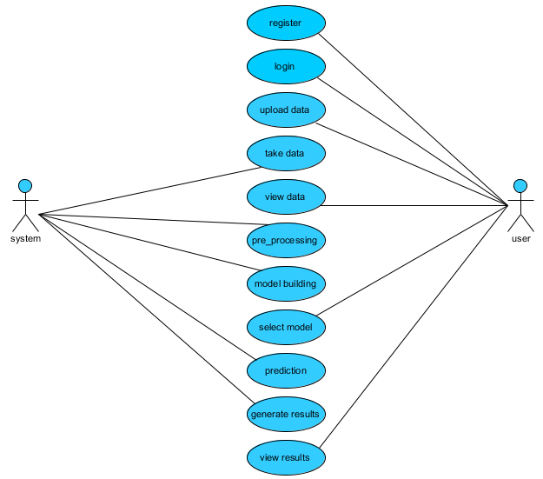

Slide 28
Class diagram:
In software engineering, a class diagram in the unified modeling language (uml) is a type of static structure diagram that describes the structure of a system by showing the system's classes, their attributes, operations (or methods), and the relationships among the classes. It explains which class contains information.

Slide 29
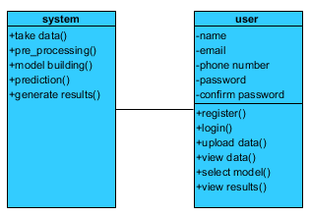

Slide 30
Sequence diagram:
A sequence diagram in unified modeling language (uml) is a kind of interaction diagram that shows how processes operate with one another and in what order. It is a construct of a message sequence chart. Sequence diagrams are sometimes called event diagrams, event scenarios, and timing diagrams.

Slide 31
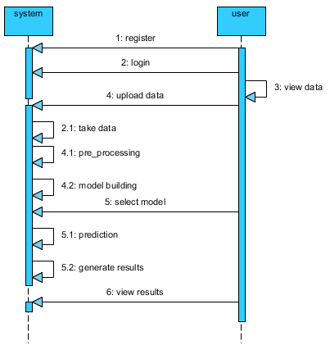

Slide 32
Collaboration diagram:
In collaboration diagram the method call sequence is indicated by some numbering technique as shown below. The number indicates how the methods are called one after another. We have taken the same order management system to describe the collaboration diagram. The method calls are similar to that of a sequence diagram. But the difference is that the sequence diagram does not describe the object organization whereas the collaboration diagram shows the object organization.

Slide 33
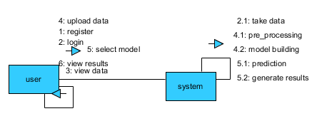

Slide 34
Deployment diagram:
Deployment diagram represents the deployment view of a system. It is related to the component diagram. Because the components are deployed using the deployment diagrams. A deployment diagram consists of nodes. Nodes are nothing but physical hard ware’s used to deploy the application.

Slide 35


Slide 36
Component diagram:
Component diagrams are used to describe the physical artifacts of a system. This artifact includes files, executable, libraries etc. So the purpose of this diagram is different, component diagrams are used during the implementation phase of an application. But it is prepared well in advance to visualize the implementation details. Initially the system is designed using different uml diagrams and then when the artifacts are ready component diagrams are used to get an idea of the implementation.

Slide 37
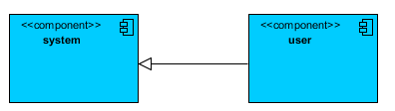

Slide 38
Activity diagram:
Activity diagrams are graphical representations of workflows of stepwise activities and actions with support for choice, iteration and concurrency. In the unified modeling language, activity diagrams can be used to describe the business and operational step-by-step workflows of components in a system. An activity diagram shows the overall flow of control.

Slide 39
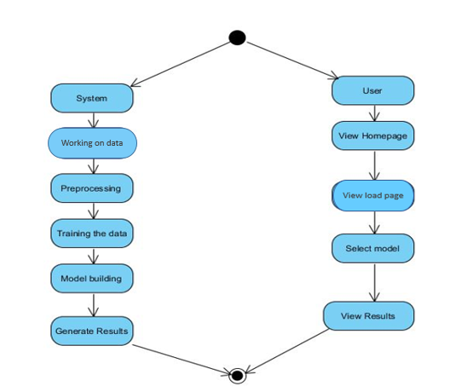

Slide 40
ER Diagram:
An Entity–relationship model (ER model) describes the structure of a database with the help of a diagram, which is known as Entity Relationship Diagram (ER Diagram). An ER model is a design or blueprint of a database that can later be implemented as a database. The main components of E-R model are: entity set and relationship set.

Slide 41
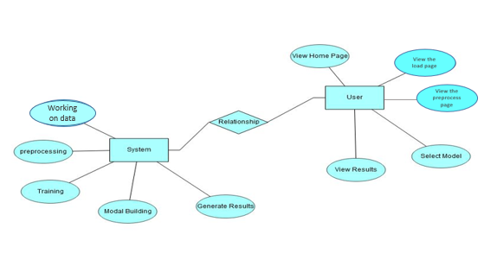

Slide 42
DFD Diagram:
A Data Flow Diagram (DFD) is a traditional way to visualize the information flows within a system. A neat and clear DFD can depict a good amount of the system requirements graphically. It can be manual, automated, or a combination of both. It shows how information enters and leaves the system, what changes the information and where information is stored. The purpose of a DFD is to show the scope and boundaries of a system as a whole. It may be used as a communications tool between a systems analyst and any person who plays a part in the system that acts as the starting point for redesigning a system.

Slide 43
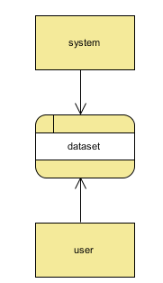
Context Level Diagram:

Slide 44
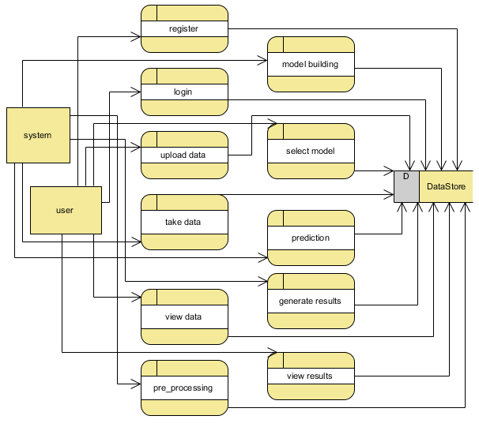
Level 1 Diagram:

Slide 45
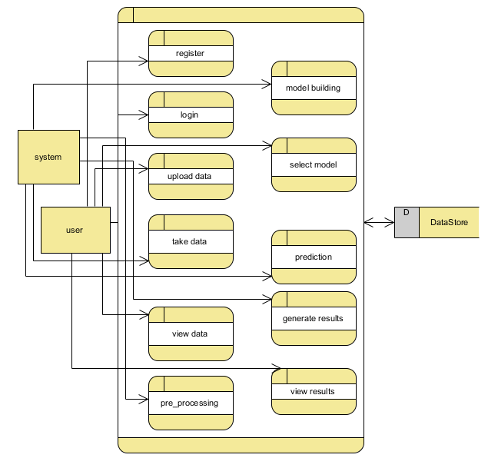
Level 2 Diagram:

